Slide 1
Exploratory Data Analysis
Visualization

Slide 2
Introduction
What is Exploratory Data Analysis ?
Understanding the data sets by summarizing their main characteristics often plotting them visually.
This step is very important especially when we arrive at modeling the data in order to apply Machine learning.
Possible examples could be Histograms, Box plot, Scatter plot and many more.
It often takes much time to explore the data.
Through the process of EDA, we can ask to (re)define the problem statement or business question on our data set
How to perform Exploratory Data Analysis ?
Depends on the data set that you are working.
There is no one method or common methods
Understand some common methods and plots that would be used in the EDA process.
Example
Data-set of cars from Kaggle.
Downloaded from here. (https://www.kaggle.com/CooperUnion/cardataset)
Contains 10, 000 rows and more than 10 columns which contains features of the car such as Engine Fuel Type, Engine HP, Transmission Type, highway MPG, city MPG and many more.
We will explore the data and make it ready for modeling.

Slide 3
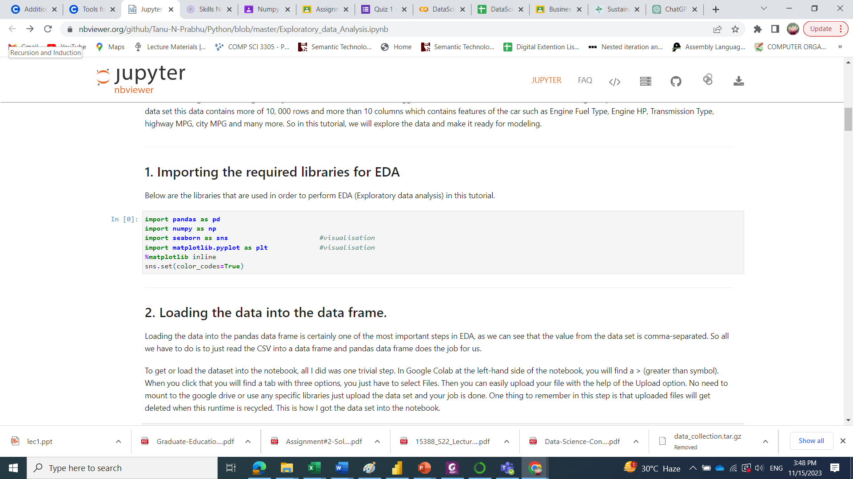
1. Importing the required libraries for EDA Following libraries will be used to perform EDA (Exploratory data analysis).

Slide 4
2. Loading the data into the data frame.
Loading the data into the pandas data frame is one of the most important steps in EDA,
read the CSV into a data frame and pandas data frame does the job for us.
To get or load the dataset into the notebook,
In Google Colab at the left-hand side of the notebook, you will find File Folder option.
When you click that you will find a tab with few other options
You just have to select Upload Files.
Then you can easily upload your file with the help of the Upload option.
No need to mount to the google drive or use any specific libraries just upload the data set and your job is done.
One thing to remember in this step is that uploaded files will get deleted when this runtime is recycled.
See example

Slide 5
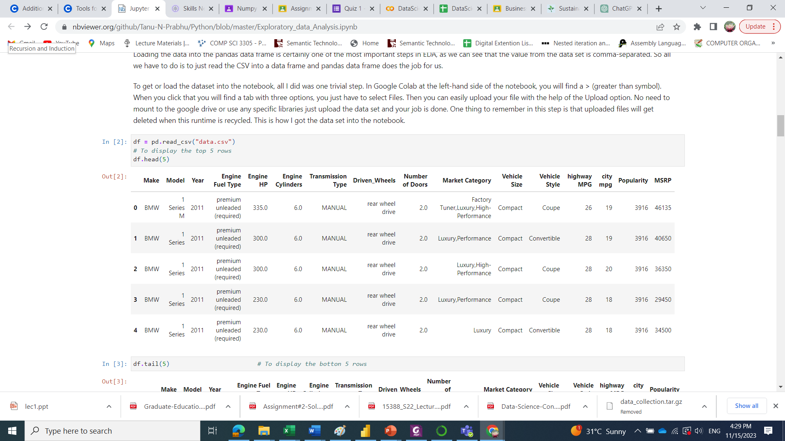

Slide 6
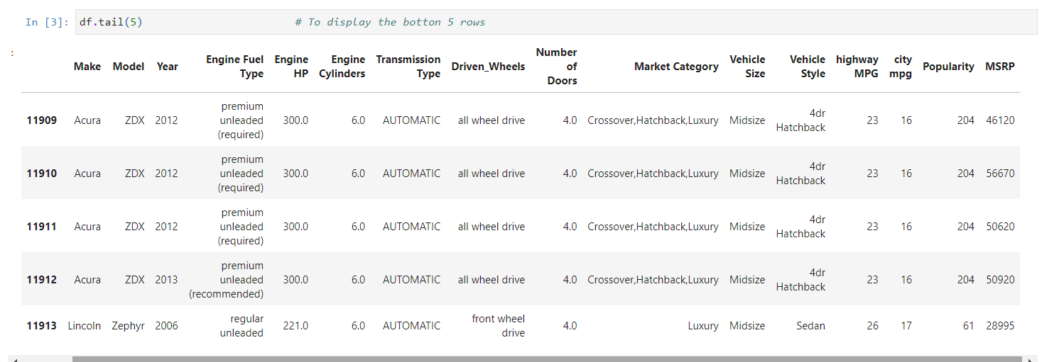

Slide 7
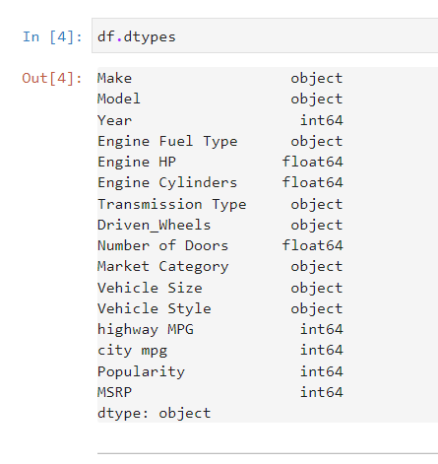
3. Checking the types of data
In this step we check for the datatypes
Price of the car may be stored as a string,
need to convert to the integer data to plot graph.
Not in this example

Slide 8
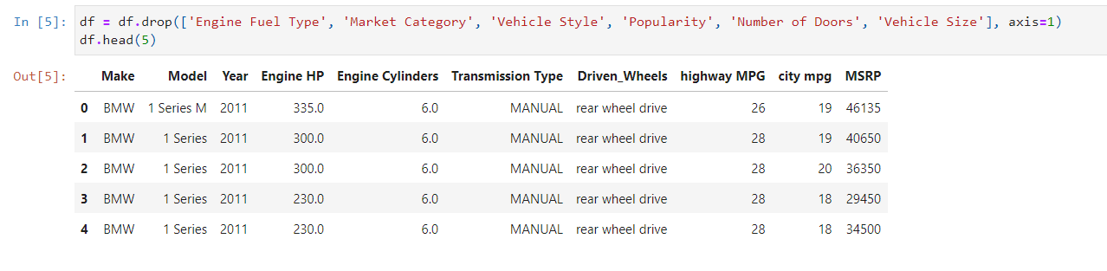
4. Dropping irrelevant columns
This step is needed in every EDA to avoid many columns that we never use
The columns such as Engine Fuel Type, Market Category, Vehicle style, Popularity, Number of doors, Vehicle Size for example may not be needed
Depends on Business Objective

Slide 9
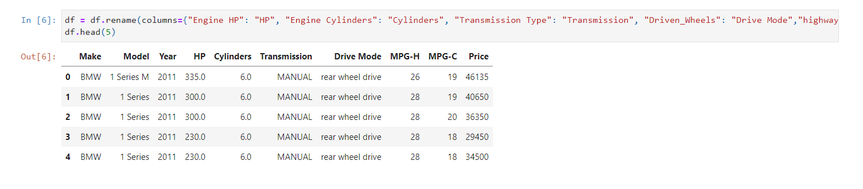
5. Renaming the columns
This step is required if column names are confusing to read
Improves the readability of the data set.

Slide 10
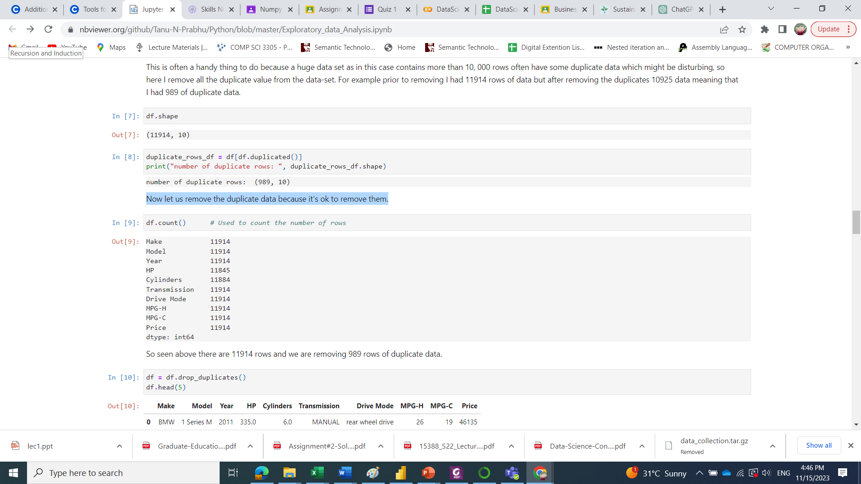
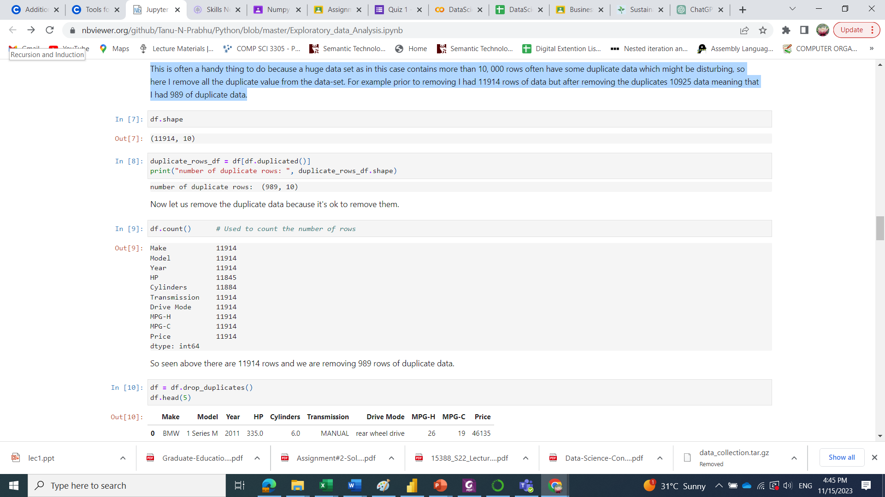
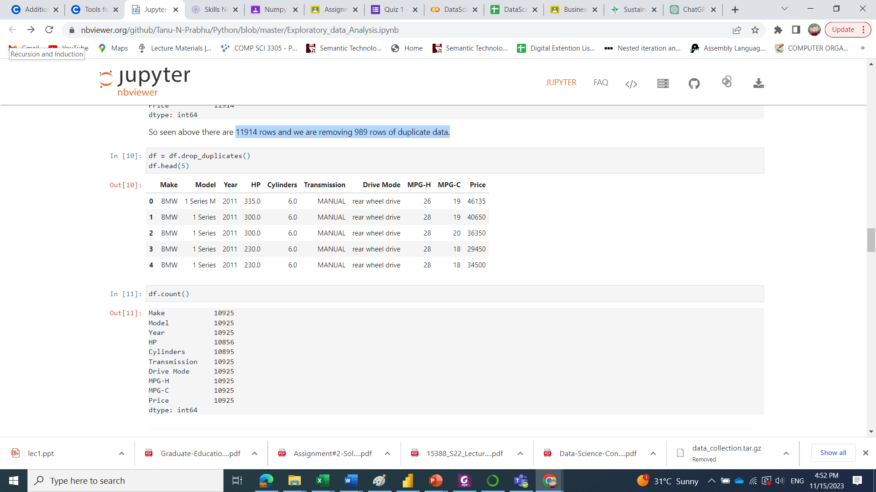
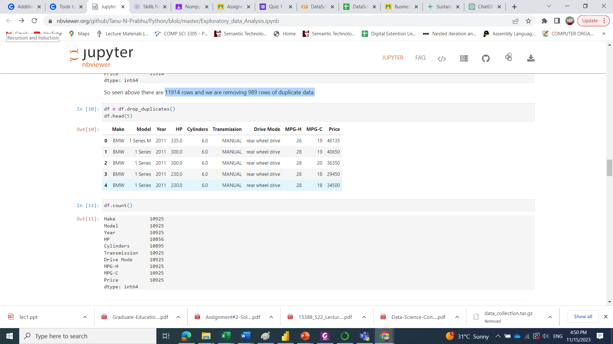
6. Dropping the duplicate rows
A Data Cleaning operation
Huge data set may contain more than 10,000 rows with duplicate data
Required to remove all the duplicate value from the data-set.
For example in this step prior to removing there are 11914 rows of data. After removing the duplicates 10925 data
989 of duplicate data has been dropped
11914 rows in total. Requires to remove 989 rows of duplicate data.
Now let us remove the duplicate data

Slide 11
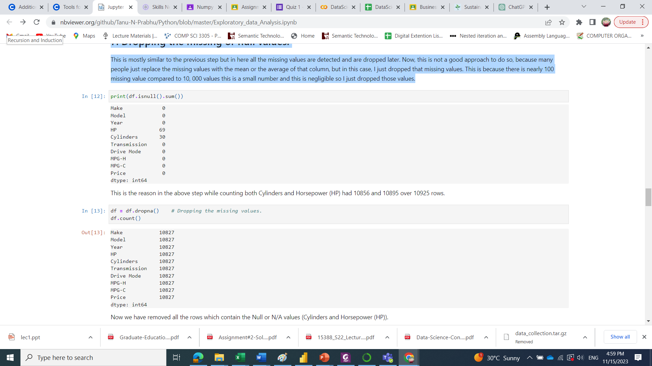
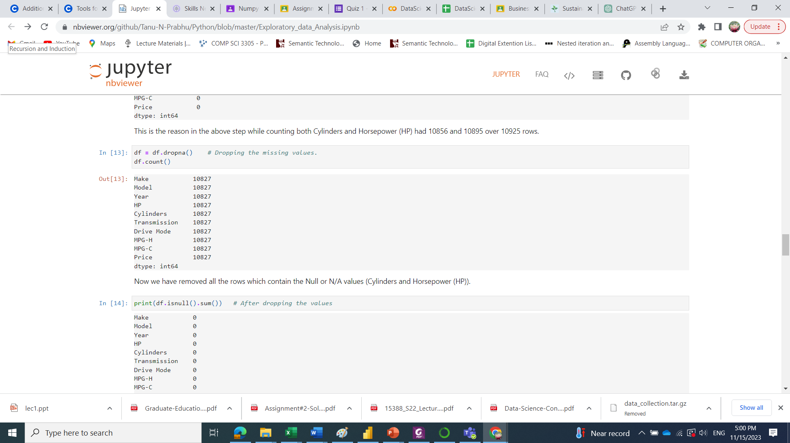
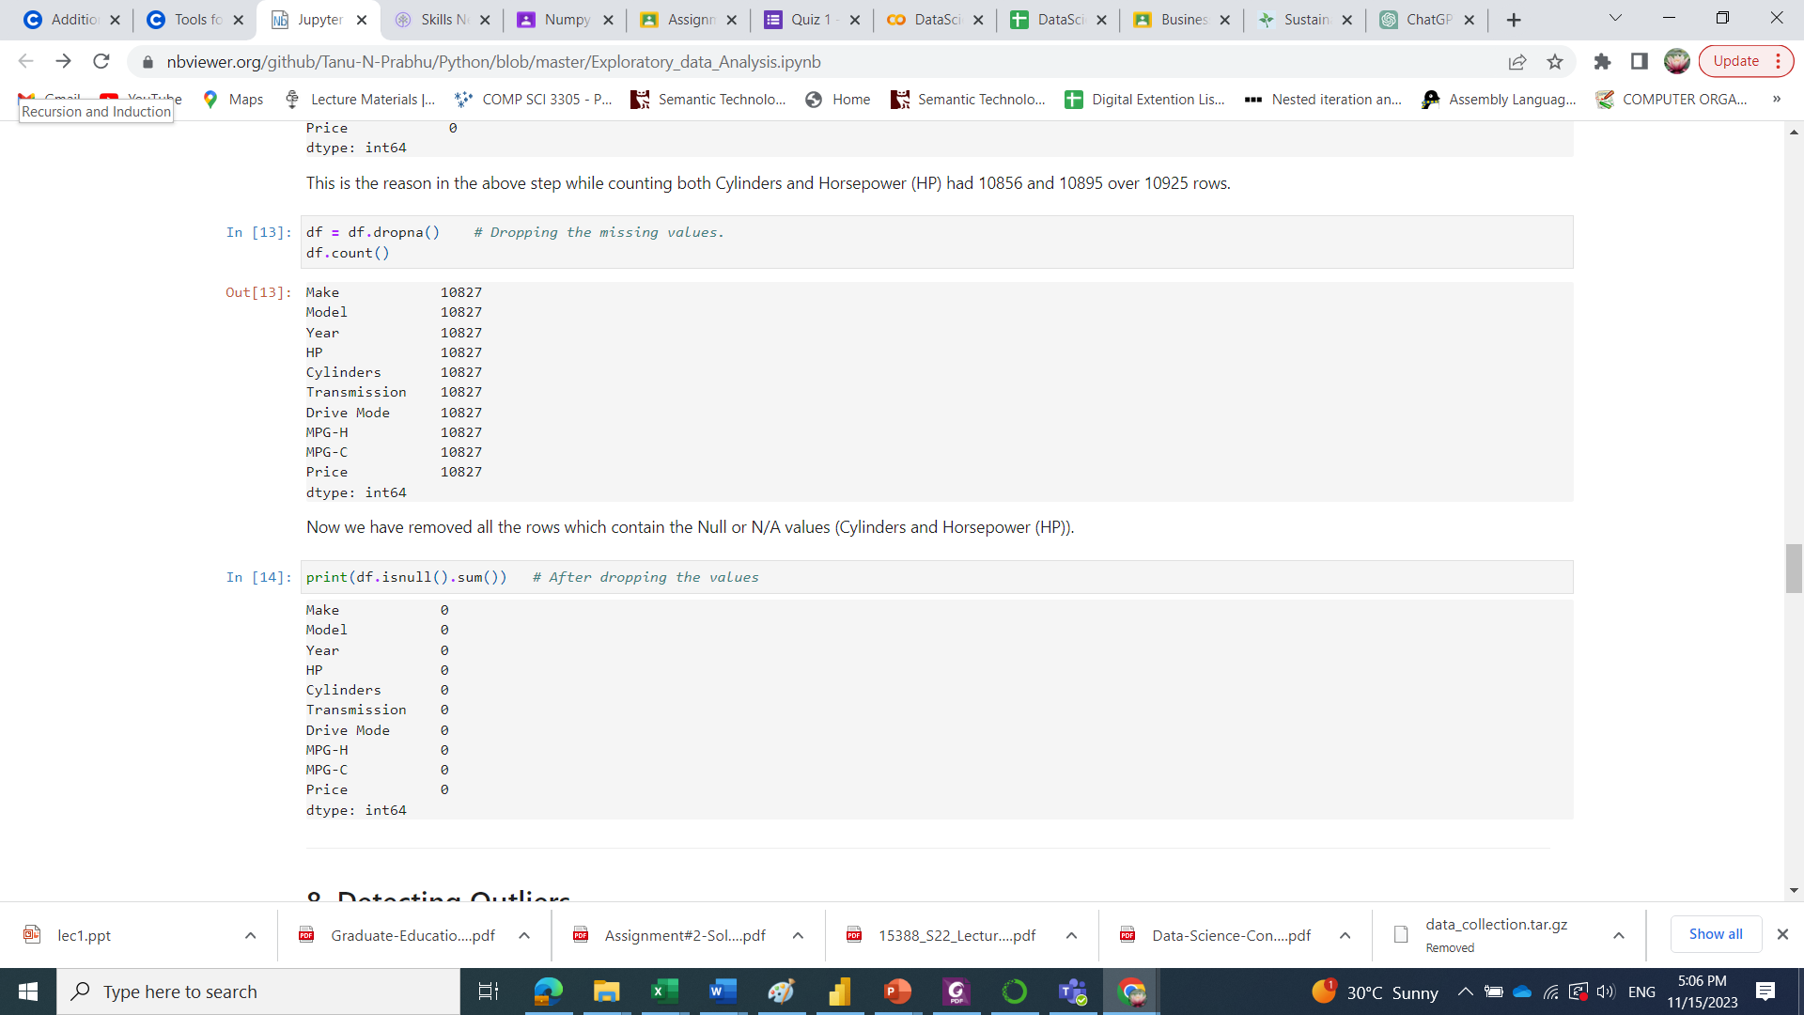
7. Dropping the missing or null values.
All the missing values are detected and are then dropped.
May also replace the missing values with the mean or the average of that column
In this example there are 100 missing values compared to 10,000 values
A small number so can be dropped.

Slide 12
8. Detecting Outliers
Point or set of points that are different from other points.
Sometimes can be very high or very low.
In this step we detect and remove the outliers.
One of the primary reasons for resulting in a less accurate model.
The outlier detection and removing that I am going to perform is called IQR score technique.
Often outliers can be seen with visualizations using a box plot.
Shown below are the box plot of MSRP, Cylinders, Horsepower and EngineSize.
Herein all the plots, you can find some points are outside the box they are none other than outliers.

Slide 13
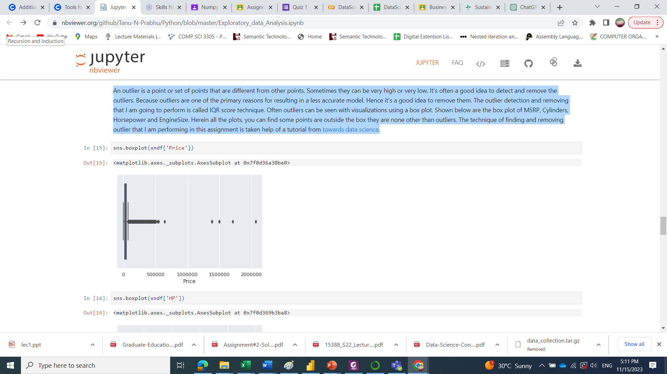
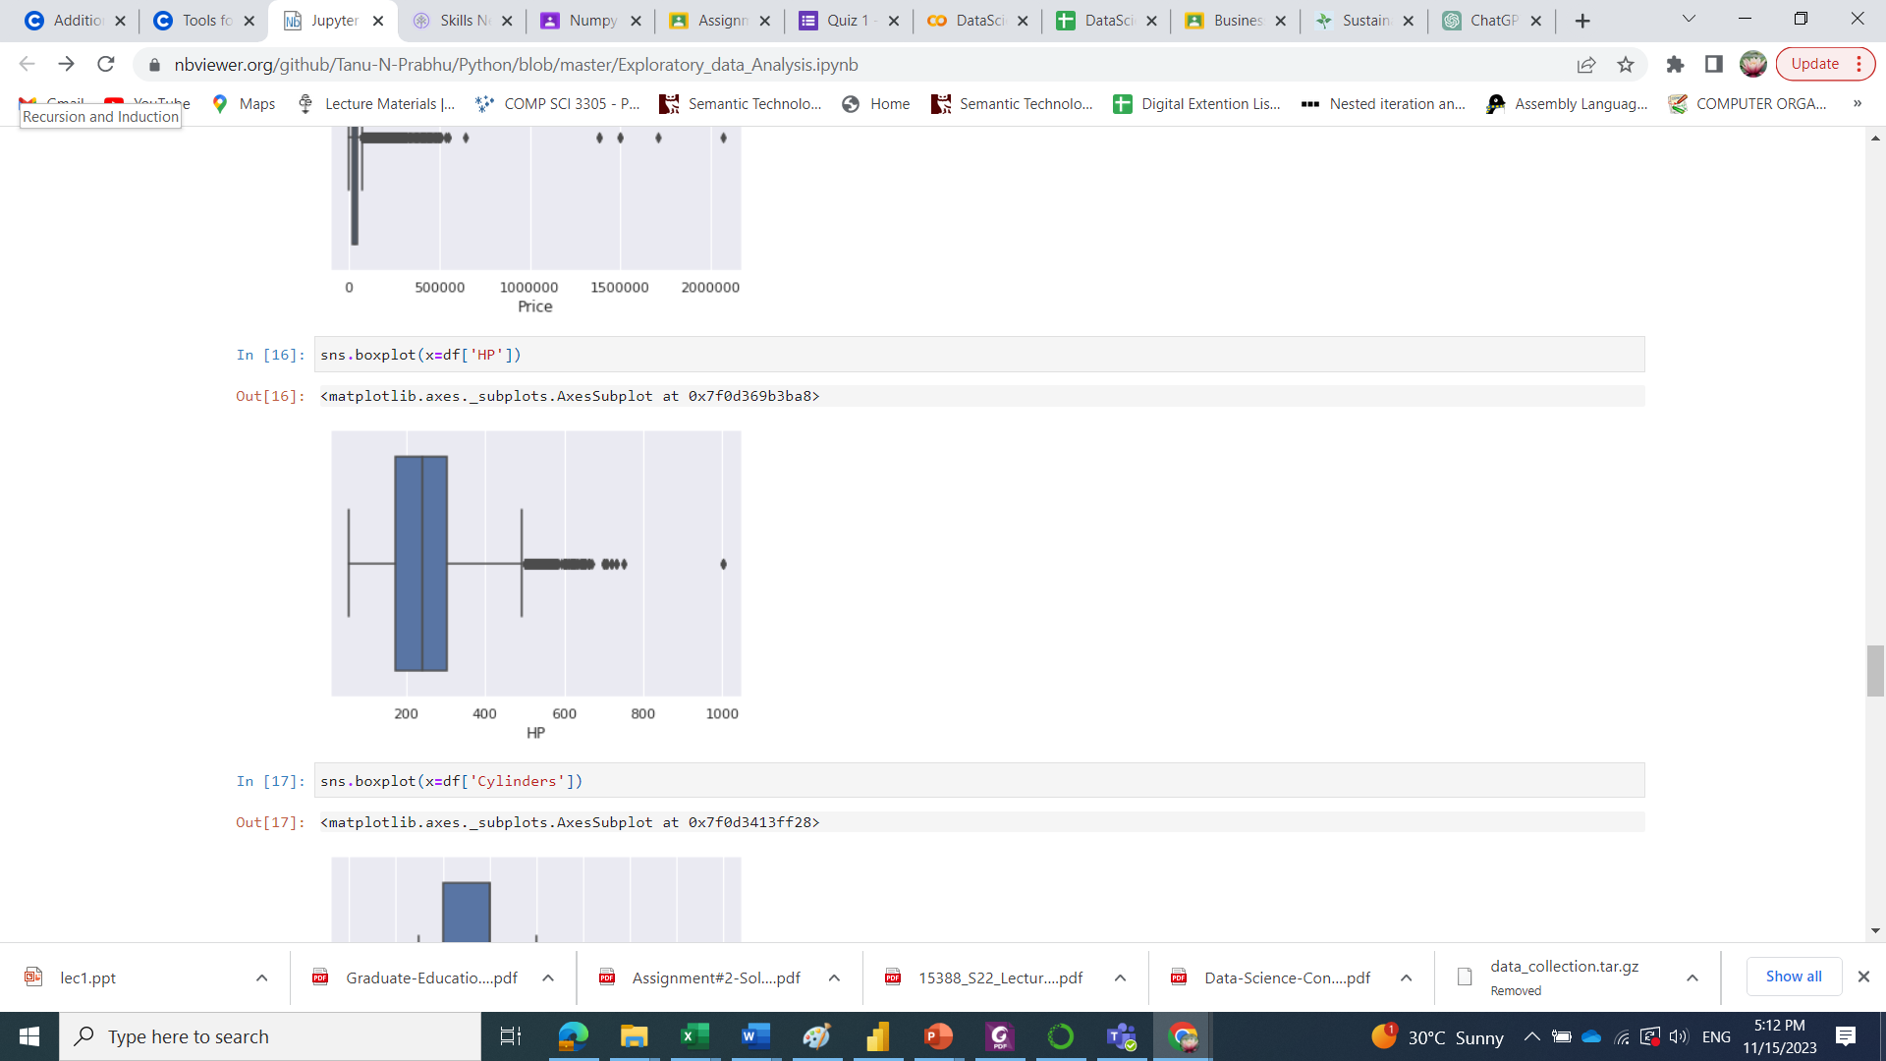
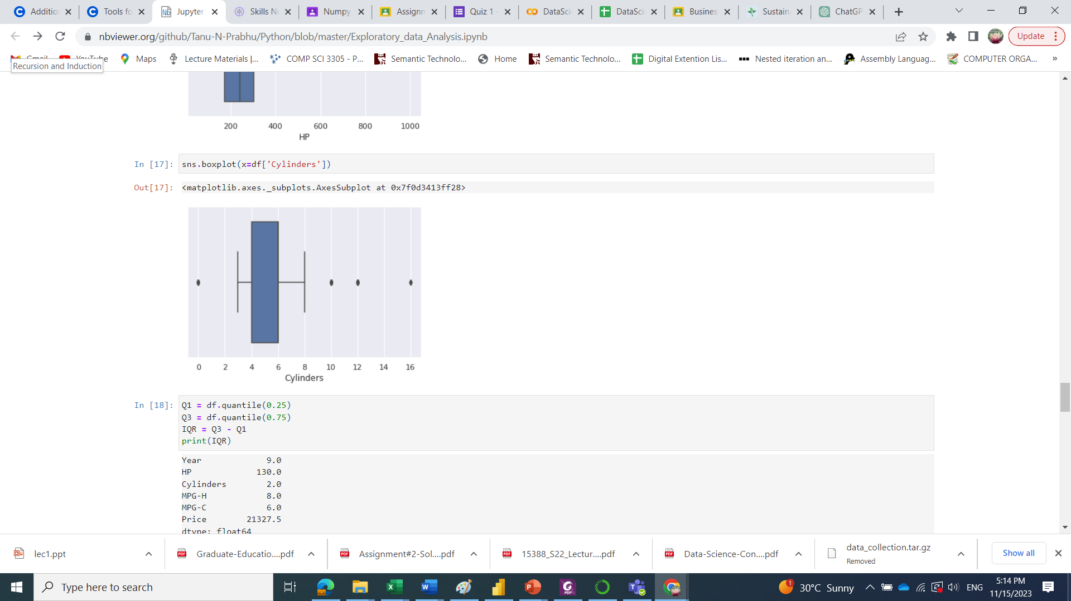

Slide 14
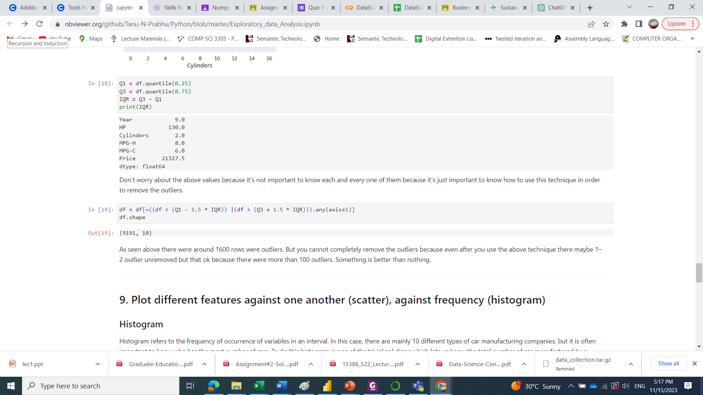
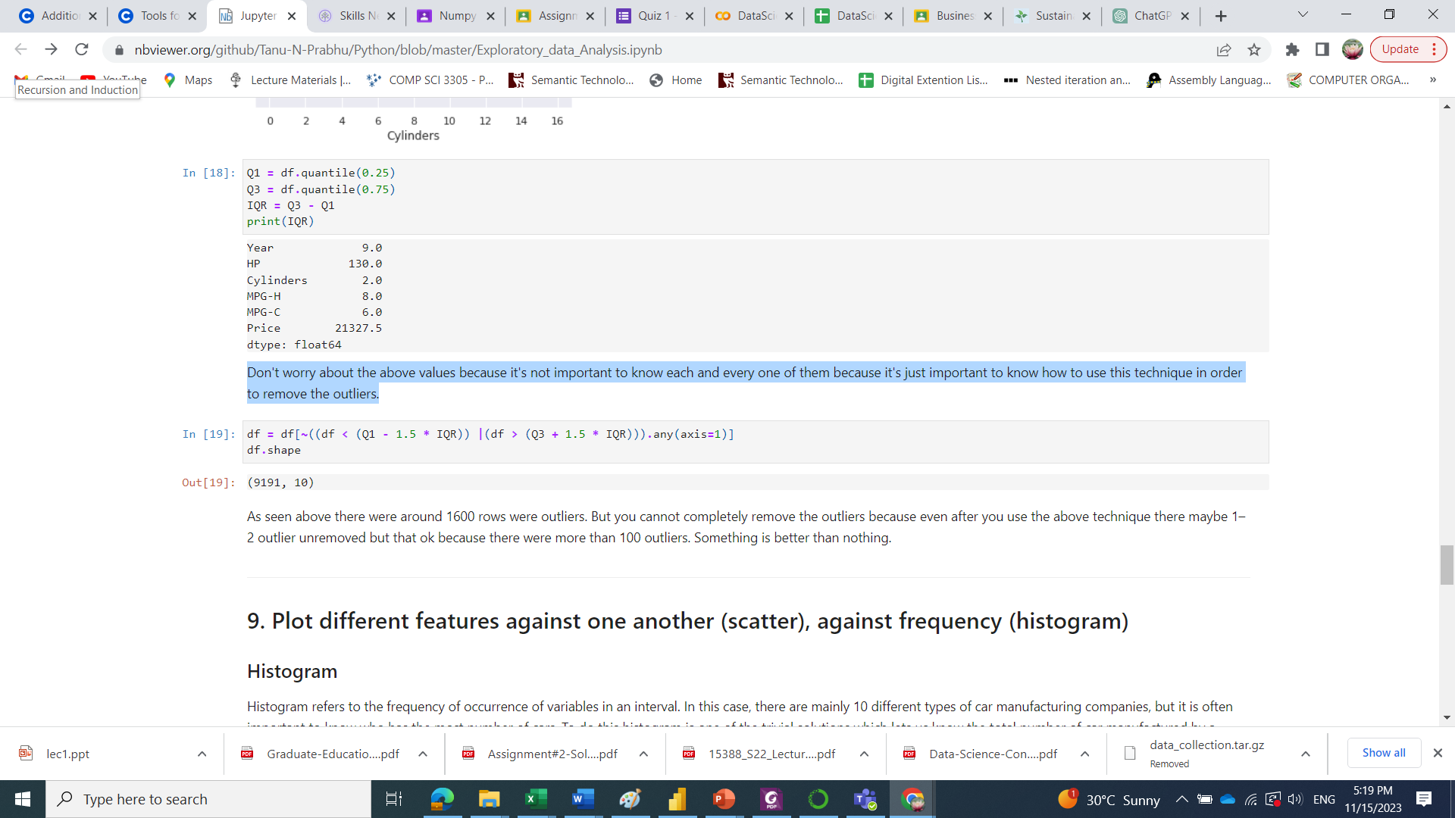
We will discuss later about IQR. Just important to know how to use this technique in order to remove the outliers.
Around 1600 rows were outliers.

Slide 15
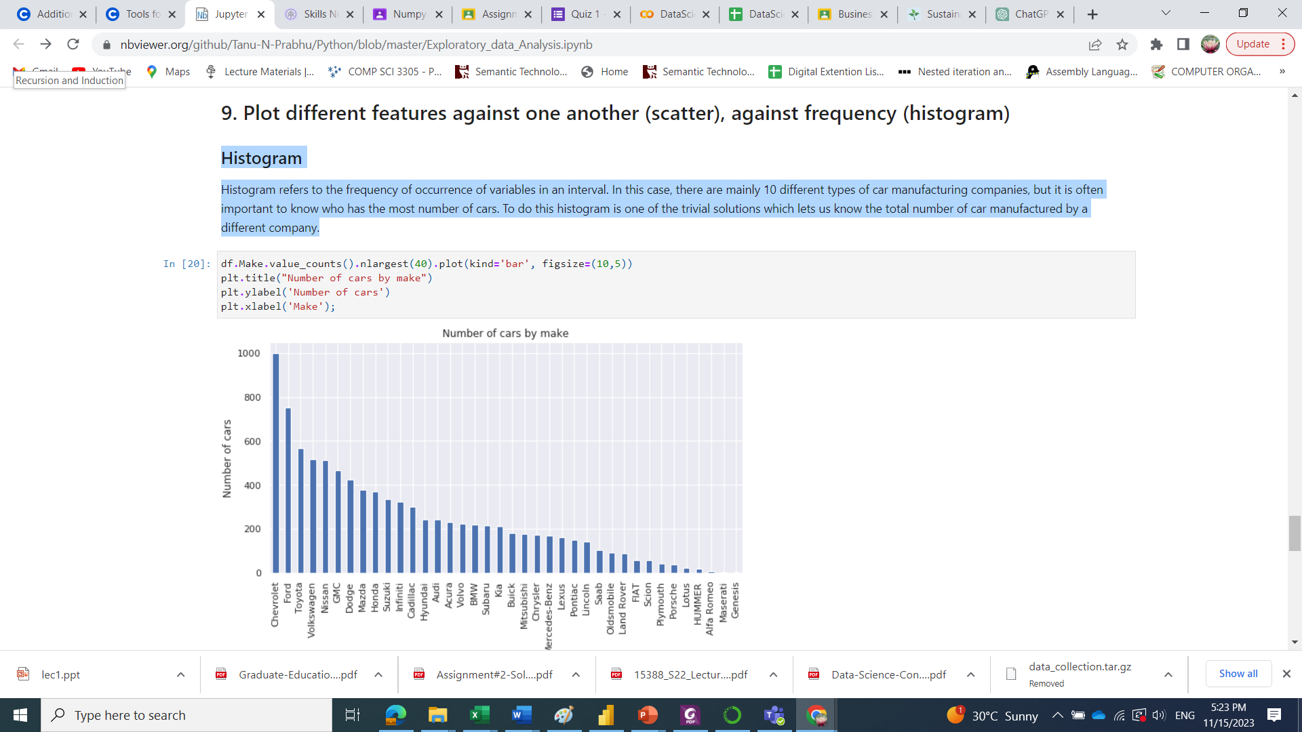
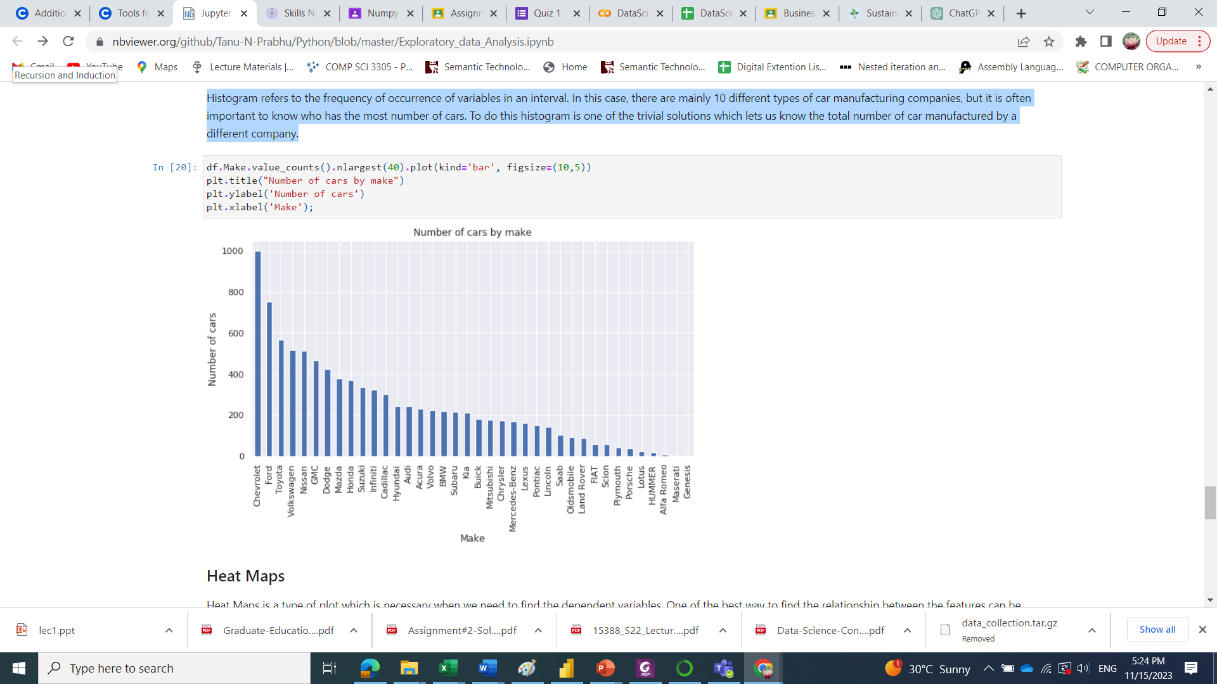
9. Plot different features against one another (scatter), against frequency (histogram)
Histogram
Refers to the frequency of occurrence of variables in an interval.
Showing who has the most number of cars.
The total number of car manufactured by a different company.

Slide 16
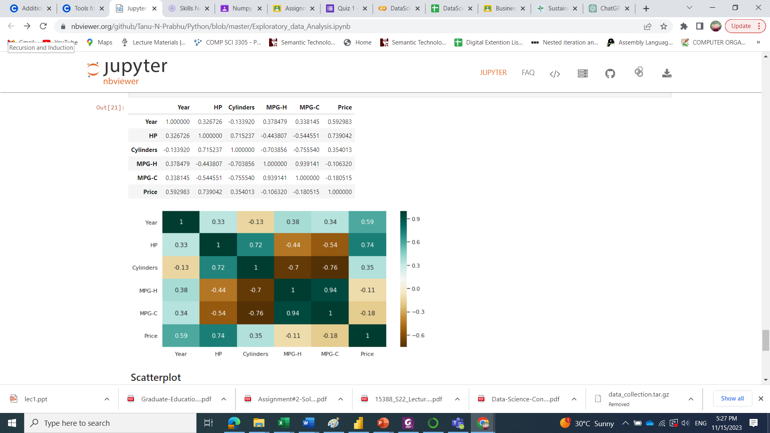
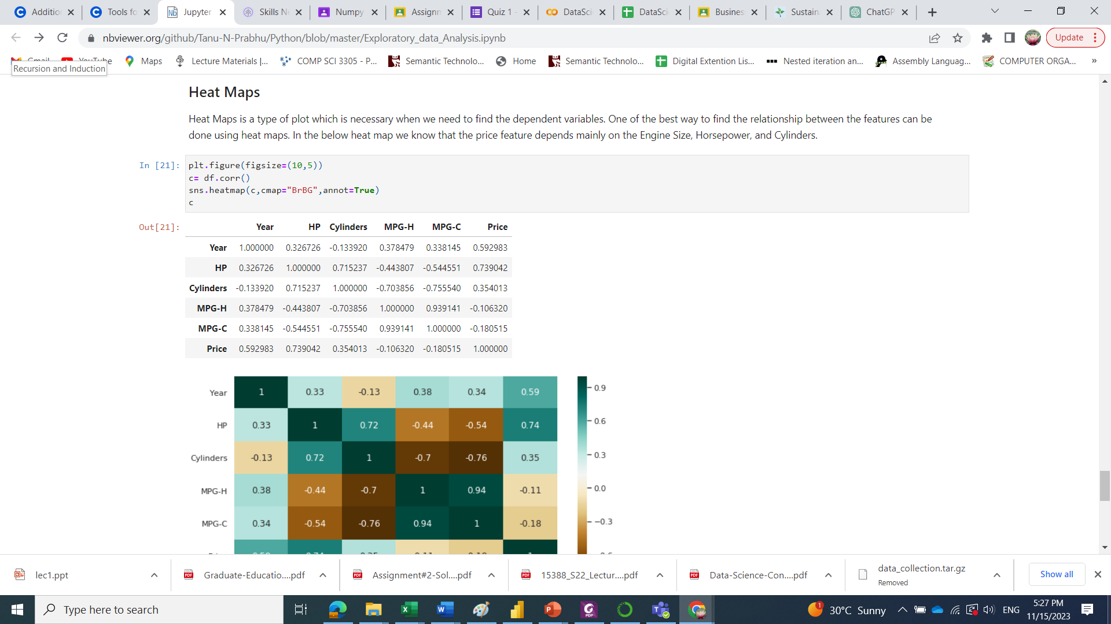
9. Plot different features against one another (scatter), against frequency (histogram)
Heat Maps
Heat Maps is a type of plot which is necessary when we need to find the dependent variables.
Price feature depends mainly on the Year, Horsepower, and Cylinders.

Slide 17
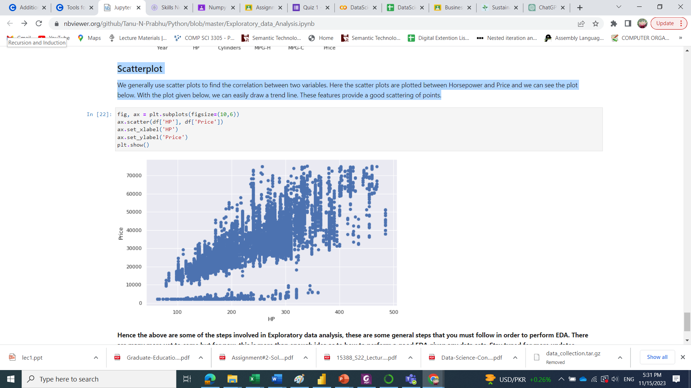

9. Plot different features against one another (scatter), against frequency (histogram)
Scatterplot
Used to find the correlation between two variables.
Here the scatter plots are plotted between Horsepower and Price
With the plot given below, we can easily draw a trend line.
These features provide a good scattering of points.

